Slide 1
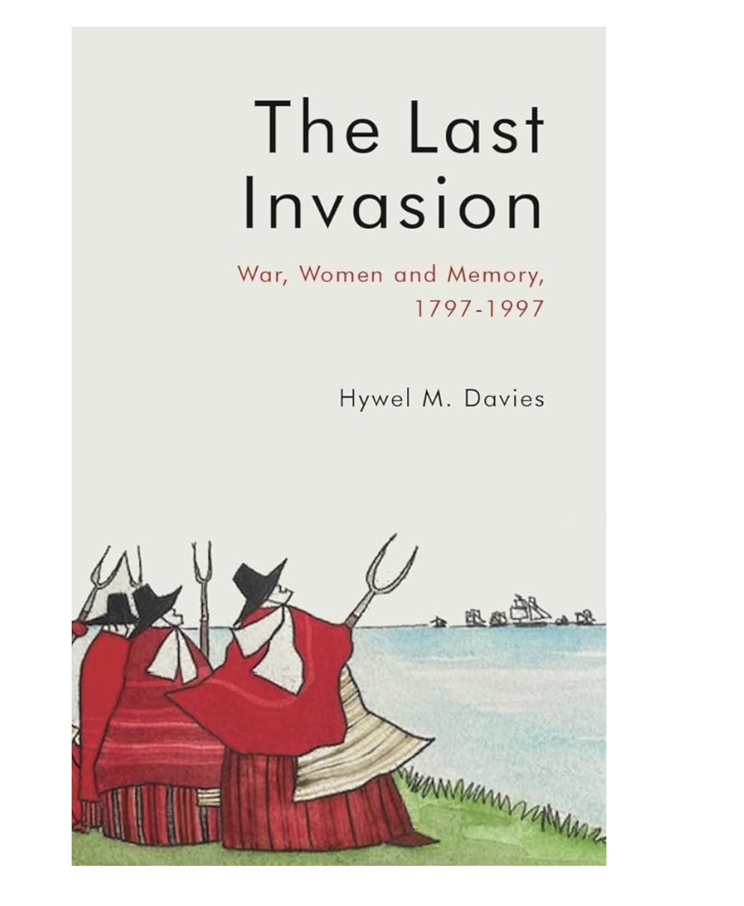
HYWEL M DAVIES ODA LECTURE 12 MARCH 2025
Notes:
Thanks to my old school for the invitation to give this lecture based on my book, published by the University of Wales Press in February 2025. Available for £24.99.

Slide 2
Notes:
Blue plaque unveiled by Jane Hutt in 2024. Jemima is now officially ‘remarkable’. Stock image of Jemima with her pitchfork rounding up French soldiers with a sheepdog. The sheepdog is a recent addition .Jemima belongs as much to the present as she does to the past

Slide 3
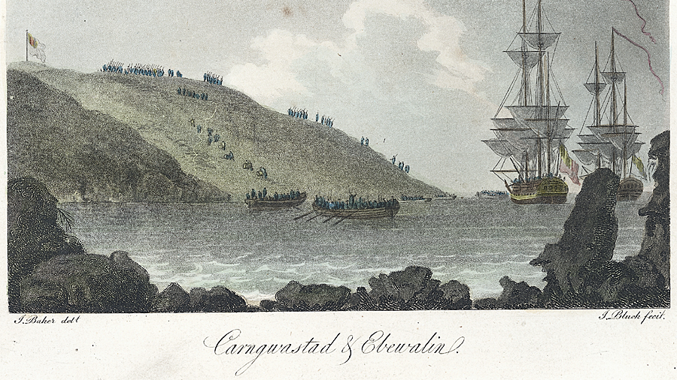
Notes:
From James Baker’s account of the invasion , the earliest in print, dated May 1797. The cliff ascent as depicted is much easier than it was. Baker was an English topographer who had difficulty with Welsh place names. ‘Ebewalin’ is Aberfelin. Baker may have lived in Fishguard for a while, he did confer with the locals in writing his account.

Slide 4
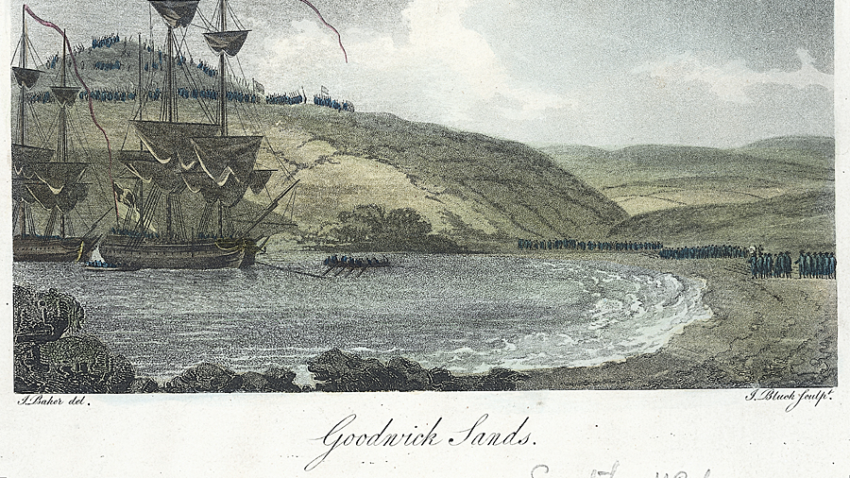
Notes:
The ships , some of the most modern in the French fleet ,dominate the image. They had departed the scene soon after landing. Even as early as May 1797 aspects of the story were confused. The landscape is one of confrontation of opposing forces, note the flags. The civilians are at the top of the hill

Slide 5
The lives of three women, prominent in the Invasion story my theme this evening.
I won’t name them yet
The act of naming , identifying, is part of the narrative development and process.
Notes:
I can only bring them to ‘life’ up to the centenary in 1897 due to time constraints, to learn more please see the book.

Slide 6
Eyewitness accounts reported on the popular fury, irrespective of age or gender
Before the militias arrived
The Welsh, it was said, fought as Ancient Britons, who had never been defeated by invaders.
Notes:
The French were intimidated by the Welsh ‘country people’ armed with their ‘country’ weapons; scythes, pitchforks, reaping hooks before the militias arrived .The term ‘Ancient Britons’ was a masculine concept which concealed the presence of women as well as boys and girls

Slide 7
The account of the “Surrender” was presented officially by Cawdor to the Home Secretary, as an orderly, well-managed process from negotiation to the universal laying down of arms. The French surrendered piecemeal and often reluctantly.
The position on the 24th , was confused, the outcome uncertain and as much in the hands of the peasantry as the military .
The accounts of the surrender and the role of the country people including the women were intricately linked.
Notes:
The popular accounts of the surrender in the newspapers and the ballads made no reference to any negotiated dealings between the opposing parties.

Slide 8
Our Dragooners sent us some companies of Dragoons after the old women of Pembrokeshire had secured the damned Republicans as it seems we are requested to call them
IOLO MORGANWG
TO
WILLIAM OWEN-PUGHE
7 MARCH 1797
Notes:
‘Old women’ was male banter used to insult and used by the military themselves against one another .Iolo refers to ‘Pembrokeshire’, men and women came to Pencaer from all parts of Pembrokeshire and Carmarthenshire too

Slide 9
An Address to the People of the United Kingdom of Great Britain and Ireland on the Threatened Invasion (1803)
Specimens of French Ferocity and Brutality in Wales
Cyfarch i Bobl Prydain Fawr ar fygythion y Ffrangcod i ruthro i’w gwlad (1804)
Esiamplau o ymddygiad creulon anifeilaidd y Ffrangcod y’Nghymru
Notes:
The translator of the English diatribe was Edward Davies, Rector of Llanarmon, Dyffryn Ceiriog who also adapted other government sponsored works into Welsh .

Slide 10
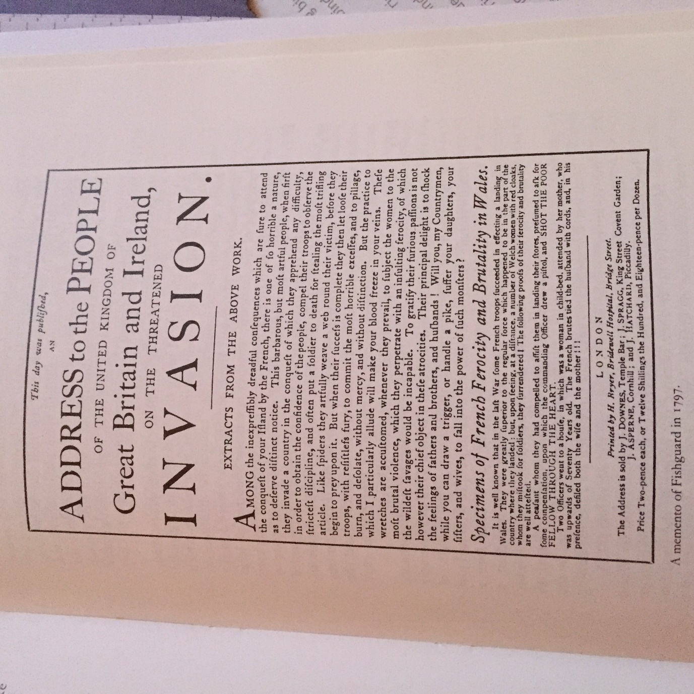

Slide 11
SPECIMENS OF FRENCH FEROCITY AND BRUTALITY IN WALES
It is well known, that in the last war, some French troops succeeded in effecting a landing in Wales. They were greatly superior to the regular force which happened to be in the part of the country where they landed; but, upon seeing at a distance, a number of Welsh women with red cloaks, whom they mistook for soldiers, they surrendered!-…..
Two officers went to a house, in which was a woman in child-bed, attended by her mother, who was upwards of 70 years old. The French brutes tied the husband with cords, and, in his presence, defiled both the wife and the mother!!”
Notes:
The language of the Welsh translation is more graphic

Slide 12
MILITARY ORDERS
FRENCH SOLDIERS:RESISTANCE IS FUTILE WE HAVE ORDERS TO VIOLATE EVERY WOMAN IN THE PARISH
YOUNG GIRLS:IT IS NOT FOR OURSELVES WE PLEAD- BUT SPARE OUR GRANDMOTHER
GRANDMOTHER :DON’T TALK SUCH NONSENSE, DON’T YOU HEAR THE GENTLEMEN SAY THEY ARE UNDER ORDERS
Notes:
An example of British misogynistic black humour. The words from the women are those of a man. Anti- French but also anti-women.

Slide 13
THE FIRST JEMIMA
an old woman, who imagining that she had little to fear from invaders, and impelled by a strong feeling of curiosity, wandered from the town, that she might have a nearer view of the enemy, in about an hour she returned, and to the utter astonishment of the inhabitants, in company with a French soldier whom she had taken prisoner, and who had been found willing to exchange his liberty for a promise of food and shelter
A voyage round Great Britain: undertaken in the summer of the year 1813, and commencing from the Land's-End, Cornwall / by Richard Ayton; with a series of views, illustrative of the character and prominent features of the coast, drawn and engraved by William Daniell, Vol. 1 (London, 1814), p. 127
Notes:
Jemima herself was very much alive when this account was written . In 1814 it is her inquisitiveness not her bravery that is highlighted

Slide 14
The details at this embryonic stage are:
the story comes from the neighbourhood itself,
the act is of ‘curiosity’ not valour and is performed by a woman, an ‘old woman’,
the woman had come from Fishguard town,
she had captured a French soldier on her own without any male or military assistance of any kind.
Notes:
A good example of social memory

Slide 15
The other features of the story
the she-cobbler,
her great strength and size,
the pitchfork,
the liking for beer and liquor,
the inflated number of prisoners captured
were all to be added later.

Slide 16
AUTHOR: H. L. AP GWILYM, ‘A NATIVE OF THE PRINCIPALITY’
H.L.WILLIAMS NAMED AS AUTHOR IN SECOND EDITION OF 1853
HENRY LEWIS WILLIAMS OF MATHRY PARISH
NAMES THE INVASION CHARACTERS LONG KNOWN IN THE COMMUNITY,JEMIMA NICHOLAS AND MARY WILLIAMS FIRST IDENTIFIED BY NAME IN 1842
Notes:
An Authentic Account, verified by two respectable veterans of the invasion still alive and living in Fishguard.

Slide 17
It was Ap Gwilym who immortalised Jemima Nicholas and it was he too who named the victim of rape, Mary Williams.
Mary Williams, Carlem, seeing the enemy approach her house attempted to escape from them through a field; the Frenchmen fired at her, wounded and otherwise ill treated her
Notes:
Carlem was Caerlem, a farm on the peninsula. Thomas Williams who led the French officers from Pencaer to Fishguard to parley was known as her husband. Mary Williams was alive when Ap Gwilym wrote his Authentic Account

Slide 18
NEGLECTED TEXT: The French at Fishguard in 1797
One poor woman, still alive, named Mary Williams, whom I visited at Fishguard, the mother of six children, and then pregnant with a seventh, had been brutally violated by a drunken Frenchman and when she afterwards attempted to escape, was shot at, and desperately wounded in the thigh
The author of the 1843 work knew that Mary Williams was pregnant when she was raped, ten years before it became publicly known; on her death in 1853 at the age of 88.The French at Fishguard in 1797 has ‘brutally violated’ which is nearer the truth than Ap Gwilym’s ‘otherwise ill treated her’
Notes:
Dismissed by Principal Salmon in the 1920s as a work of ‘fiction’. It is neither fiction nor history but a ‘memory product’ inspired by local remembrance. The first account that Mary Williams was pregnant when she was ‘brutally violated’, information that must have come from Mary herself.

Slide 19
METHODIST MEMORIES-MARY WILLIAMS
In the 1850s, David Meyler, the Methodist minister in Fishguard, claimed, without naming Mary Willams, that she had not suffered any ill treatment (sarhâd), ‘er y buwyd yn dweyd hyny’ (‘even though people have said so’).. Just two months after the rape Meyler wrote she gave birth to a son, whom she named Jabez, but the infant only lived a few months.
‘Adgofion Tiriad y Ffrancod’, Y Traethodydd, 12 (1856), 365
Notes:
These memories have been overlooked by historians probably because they were in Welsh.

Slide 20
1970s MALE CHAUVINISM
In 1974,John Kinross writes of Mary Williams and her pension: “She lived on a fat government pension until she was 89 so by the time she dies she had gained £2240 from the incident which made it well worth while” Kinross, Fishguard Fiasco (first ed 1974 )p 58. In the 2007 reprint the last phrase “which made it well worth while” is thankfully dropped, 2007 version p.45
Notes:
Male commentators fixate on the pension not on the violation .The pension was a source of local envy

Slide 21
METHODIST MEMORIES-JEMIMA
The Methodist minister’s Meyler’s remembrance of Jemima provides a new character trait that would be picked up by later writers in the temperance movement: ‘she received as much beer as she could drink that afternoon in the town, a drink she was very fond of throughout her life’.
Notes:
Jemima’s association with beer dates from mid nineteenth century, an effective marketing tool still used to sell beer based on Welsh history

Slide 22
THE ANTI-JEMIMA. NANSI JONES. PRODUCT OF DAVID REES, CAPEL ALS
In 1863, a stronger Nonconformist female role model than Jemima was introduced to the narrative of the French Invasion: Nansi Jones, the Nonconformist counterpart to Jemima Nicholas. There was no English language equivalent.
The saintly hymn-singing Nansi Jones represented far more acceptable Nonconformist values than those of the masculine, beer drinking, pitchfork wielding, Anglican Jemima.
Notes:
T.Cunllo Griffiths a Nonconformist minister in his lectures popularised Nansi whom he coupled with Jemima but gave Nansi precedence as a far fitting representative of Welsh Nonconformist womanhood

Slide 23
CENTENARY MEDAL . A LADDO A LEDDIR
Notes:
‘Those who kill are themselves killed’. Local remembrance of a traumatic event, not a semi comic episode, where people on both sides were both the killers and the killed. Also note the ’ Last Foreign Invasion’ and the ‘Surrender’ . It was never a ‘Battle’ .

Slide 24
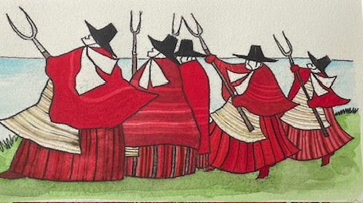
Notes:
The incomparable Ryan narrating Harri Webb’s superb comic poem on ‘The Women of Fishguard’ which encapsulated personal , cultural as well as historic references to Welsh Mams reflecting the central role of women in the history and memory of the Last Invasion

